Slide 1

DIGITAL SKILLS ( PYTHON PROGRAMMING) PROJECT NO -1
MAKING NOTEPAD USING - TKINTER
TEAM MEMBERS :
VARUN KUMAR.D -B/A1-43
NANDU.CH -B/A1-46
KANNADASAN.S -B/A1-44
SIVABOPATHI.R -B/A1-45

Slide 2
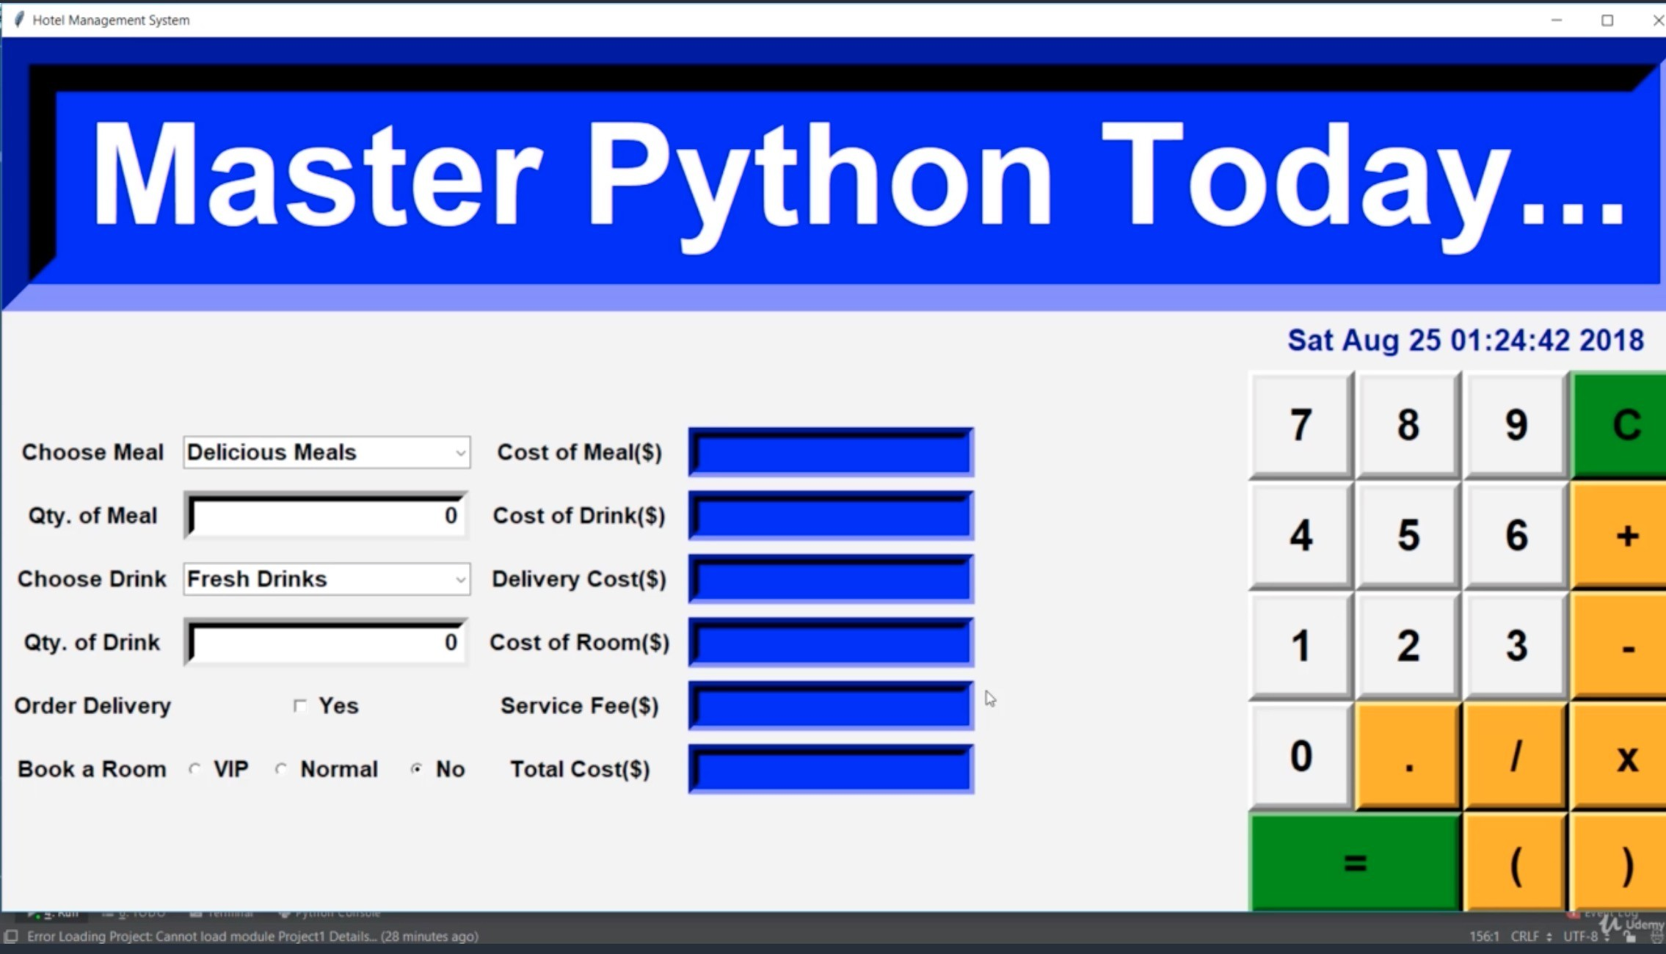
Introduction
Tkinter is a Python library used for creating graphical user interfaces (GUIs).
Notepad is a simple text editor application commonly found in various operating systems.
In this presentation, we will explore how to create a basic Notepad using Tkinter.
Notes:
Image source: https://tutorialzxy.blogspot.com/2023/04/python-gui-tkinter-tutorial.html

Slide 3
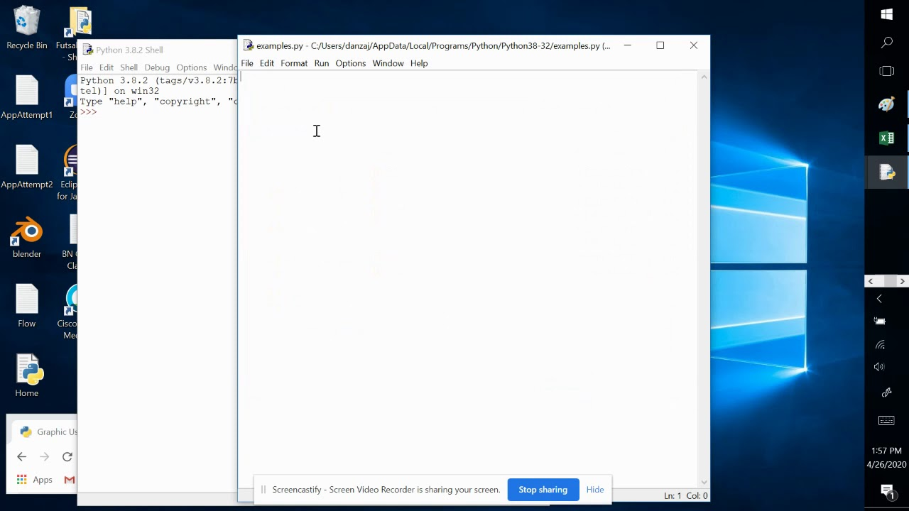
Setting Up the GUI
Import the Tkinter module and create a Tkinter window.
Add a text widget to the window where the user can input and edit text.
Include a scroll bar to navigate through the text if it exceeds the visible area.
Notes:
Image source: https://www.youtube.com/watch?v=84Ifw9Rm3Hc

Slide 4
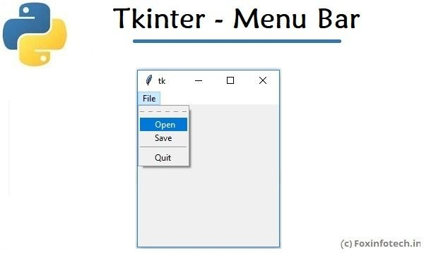
Adding Menu Options
Create a menu bar with various options such as File, Edit, and Help.
Add sub-menus under File for operations like New, Open, Save, and Exit.
Implement functionality for each menu option using Tkinter's built-in functions.
Notes:
Image source: https://www.pinterest.com/pin/317714948715895469/

Slide 5
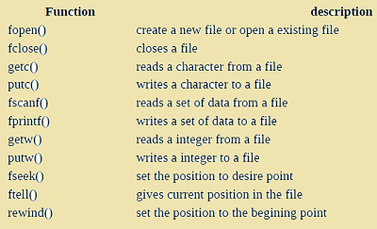
Implementing File Operations
Define functions for New, Open, Save, and Exit operations.
New should clear the text widget, Open should load a file into the widget, Save should save the content to a file, and Exit should close the Notepad.
Utilize Tkinter's file dialog boxes for selecting files and saving content.
Notes:
Image source: https://onlineexamguide.com/c-programming-28/

Slide 6
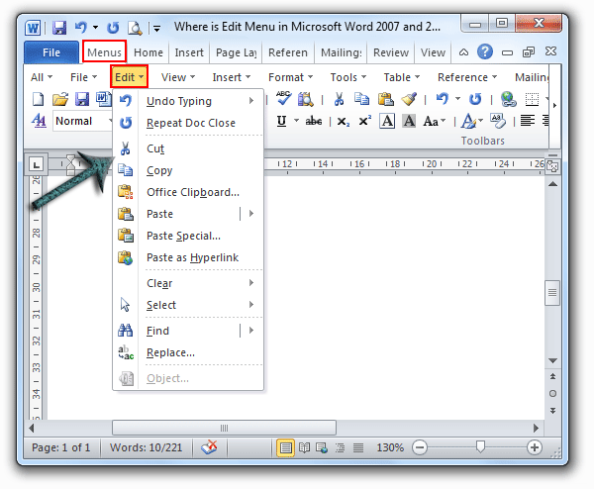
Adding Edit Options
Create sub-menus under Edit for operations like Cut, Copy, Paste, and Select All.
Implement the respective functions for each edit option using Tkinter's built-in functions.
Customize key bindings for common keyboard shortcuts like Ctrl+C for Copy and Ctrl+V for Paste.
Notes:
Image source: https://bigpng.deminasi.com/f-di-%D9%88%D8%B1%D8%AF-png.html

Slide 7
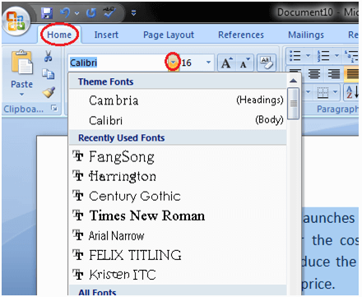
Formatting Text
Allow the user to change the font style, size, and color of the text.
Implement functionality to make the text bold, italic, or underlined.
Provide options for text alignment, such as left, center, and right.
Notes:
Image source: http://ncert-books.com/how-to-change-font-style-in-ms-word/

Slide 8
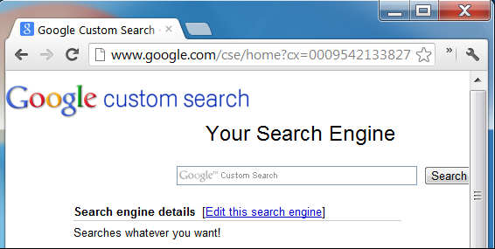
Adding Search Functionality
Include a search menu option to find specific words or phrases within the text.
Implement a search dialog box that allows the user to input the search term.
Highlight or select the found text within the text widget.
Notes:
Image source: https://widgetmefor.blogspot.com/2016/10/how-to-adding-functionality-google.html

Slide 9
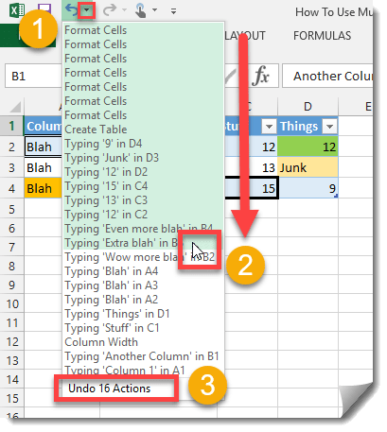
Implementing Undo and Redo
Enable the user to undo and redo their actions within the text widget.
Utilize Tkinter's undo and redo functions to implement this functionality.
Add corresponding options under the Edit menu for easy access.
Notes:
Image source: https://www.howtoexcel.org/how-to-undo-or-redo-multiple-actions/

Slide 10
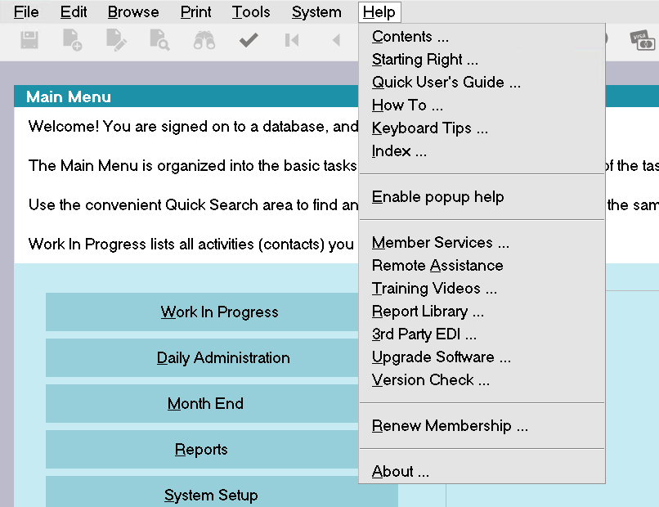
Adding Help and About
Include a Help menu option to provide assistance or access to a user guide.
Create an About menu option to display information about the Notepad application.
Implement these menu options using message boxes or separate windows.
Notes:
Image source: https://www.collect.org/cv12/Help/helpmenu.html

Slide 11
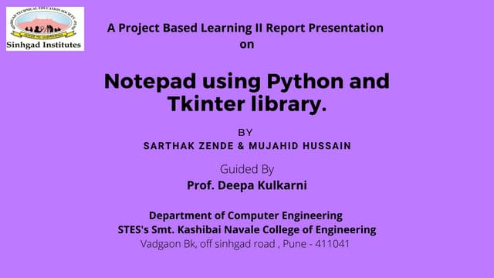
Conclusion
By following the steps outlined in this presentation, you can create a basic Notepad using Tkinter.
Tkinter offers a wide range of features and options to enhance the functionality of your Notepad application.
Feel free to explore additional Tkinter resources and experiment with different customization possibilities.
Notes:
Image source: https://www.slideshare.net/MikasaJaeger4/notepad-using-tkinterpdf

Slide 12
THANK YOU

